Slide 1
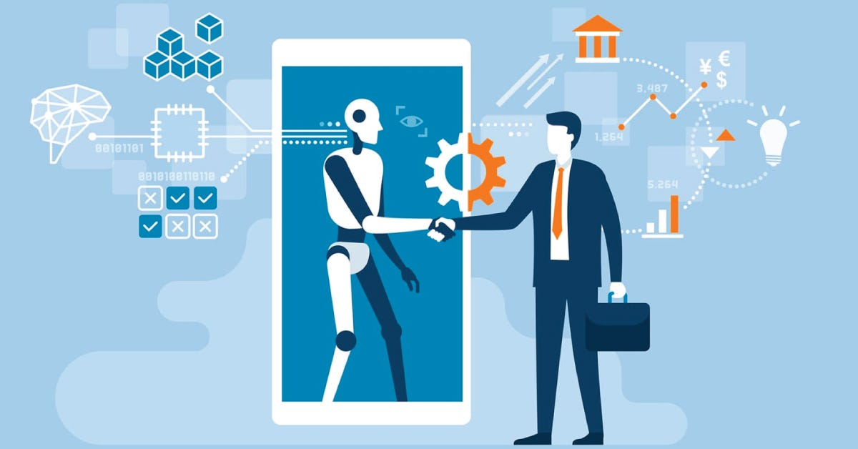

AI Driven Hyper Personalization and Recommendations Team: DLTA
Members:
1.Lokesh Tejavath
2.Aditya Srivastava
3.Stubh Lal
4.Yukti Dahiya​

Slide 2
Table of Contents
1.Problem Statement
2.Our Solution
3.Tech Stack Used
4.Model Used
5.Screenshots of UI
6.Challenges & Future Scope
7. Team Members

Slide 3
Introduction
AI-driven hyper personalization tailors content, products, and services in real-time.
Uses AI, machine learning, and big data to adapt to user preferences dynamically.
Improves engagement, satisfaction, and retention by delivering relevant experiences.
Businesses benefit from higher conversions, customer loyalty, and optimized marketing.
“
”
DLTA

Slide 4
Problem Statement
Modern customers expect highly personalized experiences that cater to their unique preferences. In this hackathon, participants will develop a Generative AI-driven solution that enhances hyper-personalization by analyzing customer profiles, social media activity, purchase history, sentiment data, and demographic details. The challenge is to design a system that generates personalized recommendations for products, services, or content while also providing actionable insights for businesses to optimize customer engagement
DLTA

Slide 5
Our Solution
Preferred products
Suggesting financial products from our options based on user history
Considering User information evaluate the best financial products
Gen AI integration
Leveraging GenAI to understand customer requirements
Helping customer to understand the recommended products

Slide 6
Tech Stack Used
1.React js
2.Flask
3.TensorFlow, Keras, XGBoost, Pandas, Kaggle

Slide 7
Model Description
DLTA

Slide 8
Dataset
We used two publicly available datasets for this project: (a) Santander Product Recommendation and (b) Loan Approval Prediction.
The first dataset is Santander Product Recommendation (link). This dataset contains 1.5 years of customers behavior data from Santander bank to predict what new products customers will purchase. The dataset contains 23 products which we've grouped into 7 product lines to recommend.
The second dataset is Loan Approval Prediction (link). This dataset relates to loan approval applications and is generated using data from a real-life financial institution.

Slide 9
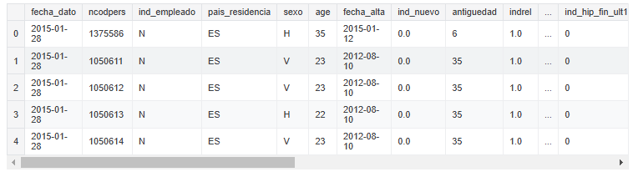
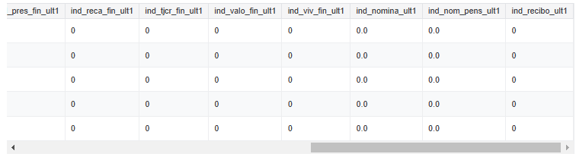
Dataset Sample: (a)

Slide 10
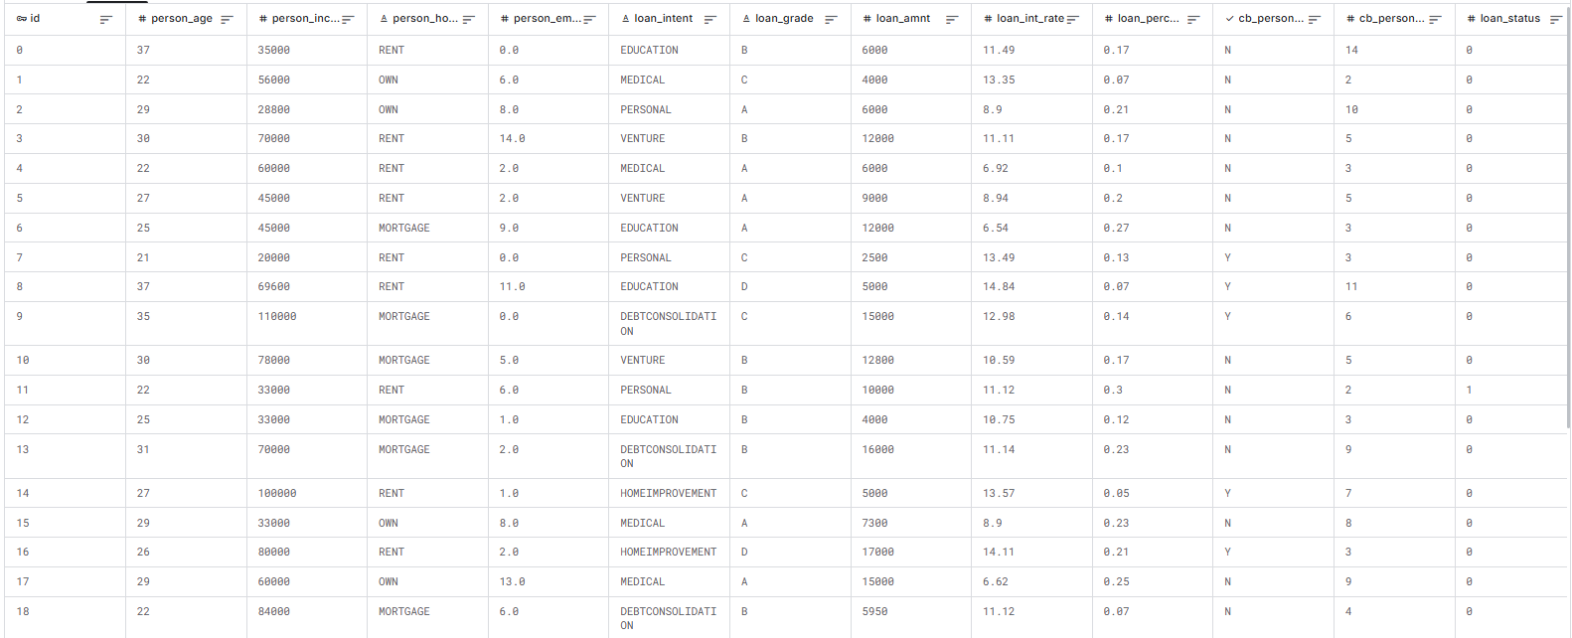
Dataset Sample: (b)

Slide 11
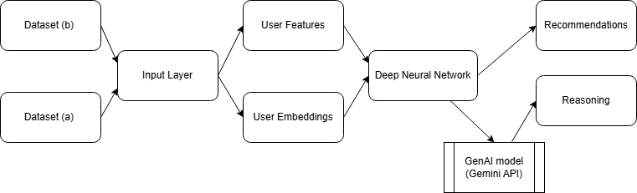
Model Flow

Slide 12
Model
We use TensorFlow and Google Gemini to build our model. We first use TensorFlow's Keras API to design a Deep Neural Network that utilizes the concept of embeddings to store a hypothetical profile for each user in the system, then using these embeddings and other collected information about the user to train the Neural Network to output recommendations.
We then feed the output of the Neural Network into a genAI model to generate reasoning for the produced output, in order to create actionable insights.
We used open-source GPUs on Kaggle to train our models.

Slide 13
Screenshots of UI

Slide 14
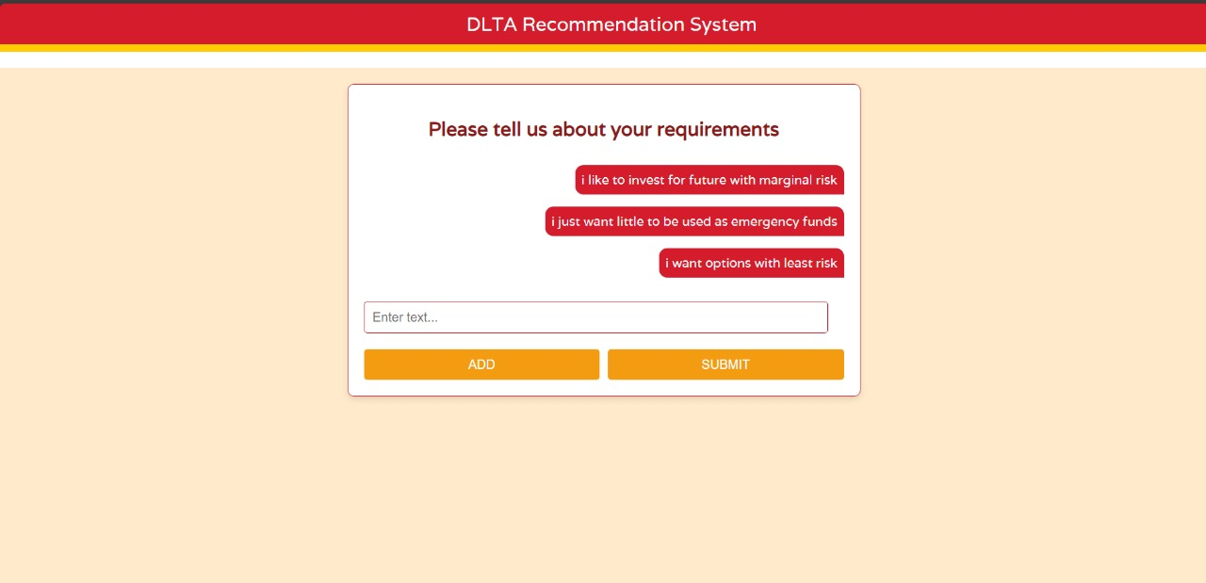

Slide 15
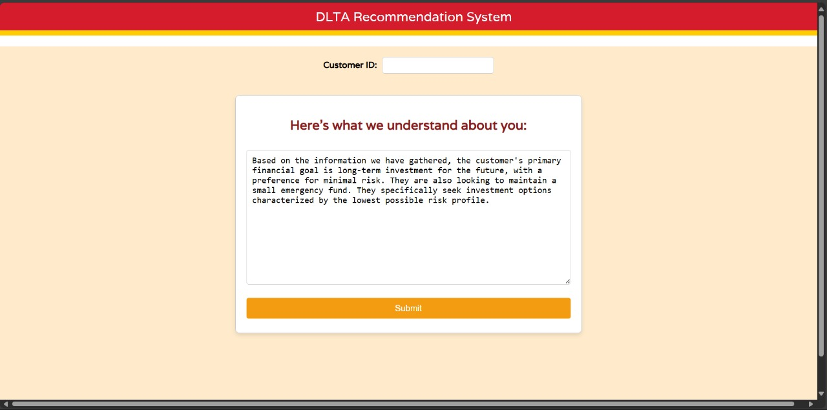

Slide 16
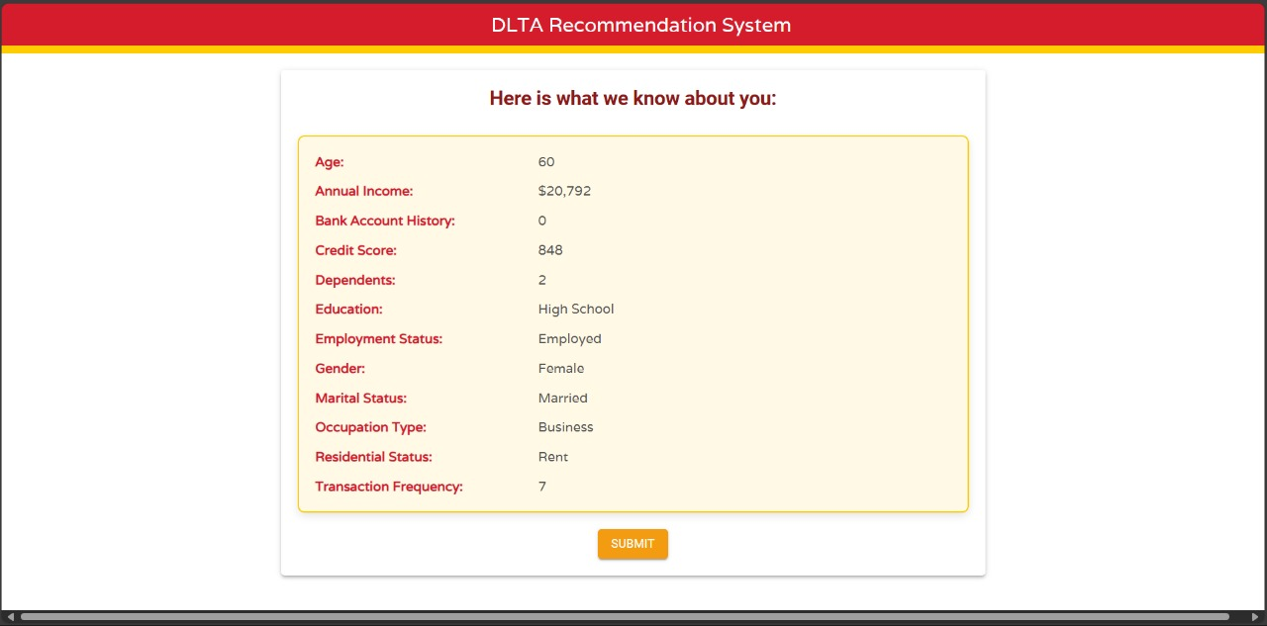

Slide 17
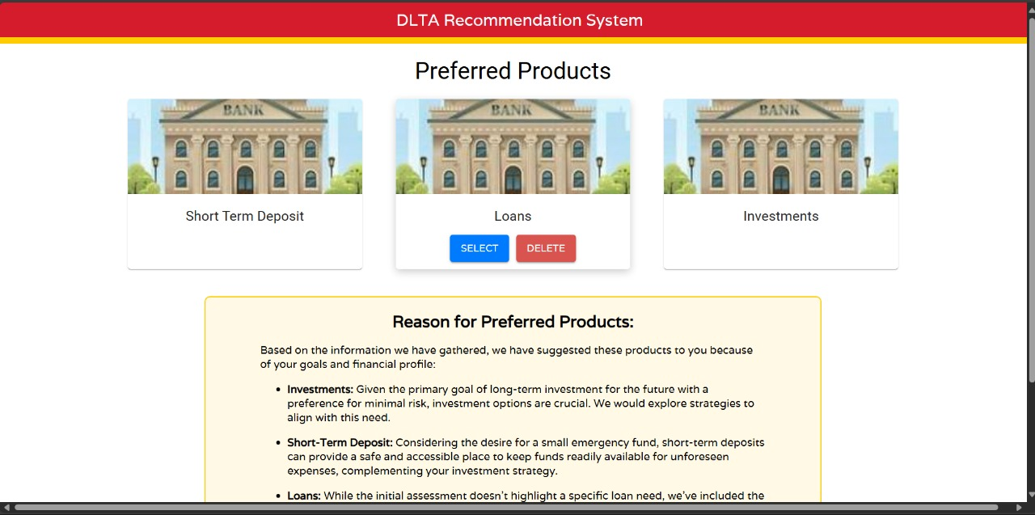

Slide 18
Challenges & Future Scope
Personalized Recommendations
Niche markets
Robust Scalable app
With having multiple options to pick from for customer, we can help customer in selection
Understands current needs of custiner ​
Pursue scalable customer service through sustainable strategies​ We can see the trends the market to change the suggestions us GENAI
With using financial data trained LLM, we can get even robust explanations and suggestions.

Slide 19
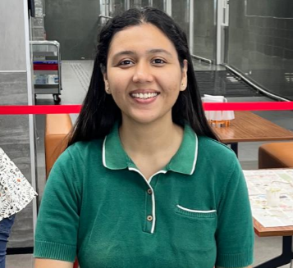

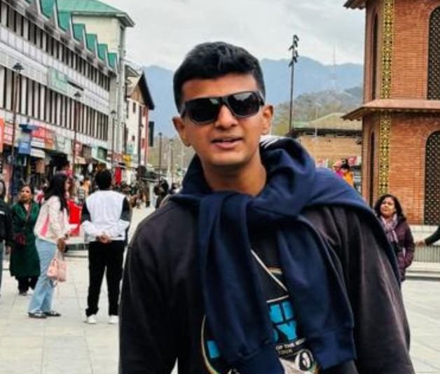


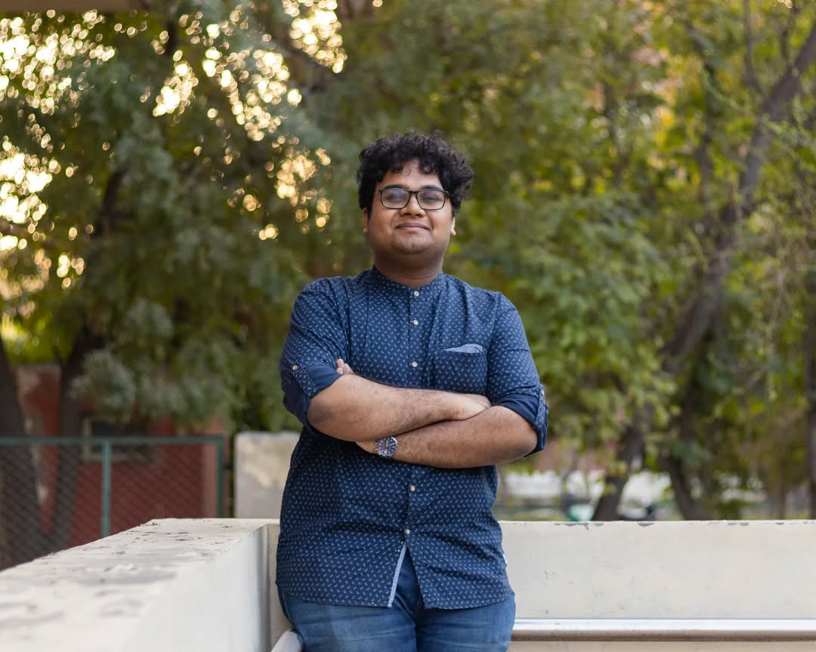
Meet our team
Lokesh Tejavath
Aditya Srivastava
Stubh Lal
Yukti Dahiya

Slide 20
Thank you

